Slide 1






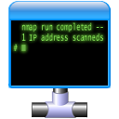




What’s New in Active Directory: Windows Server 2008 R2
Brian Desmond & Laura E. Hunter
Friday, April 24th, 2009

Slide 2
About Brian
Chicago based
Active Directory & Exchange consultant
  Moran Technology Consulting
MS MVP for Active Directory since 2003
Author of Active Directory, 4th Ed from O’Reilly
e-mail: brian.desmond@morantechnology.com
e-mail: brian@briandesmond.com
website & blog: www.briandesmond.com

Slide 3
About Laura
Philadelphia based
Senior Identity Architect
  Oxford Computer Group
MS MVP for Active Directory since 2004
Author of Active Directory Cookbook, 2nd & 3rd Ed from O’Reilly
e-mail: laura.hunter@oxfordcomputergroup.com
website & blog: www.shutuplaura.com

Slide 4

Agenda
Active Directory Recycle Bin
Managed Service Accounts
Offline Domain Join
Authentication Mechanism Assurance
Active Directory PowerShell
Active Directory Administrative Center

Slide 5
Active Directory Recycle Bin
Problem:
  Accidental deletions cause downtime
  Restoring from an accidental deletion is complicated
  Accidental deletions are the primary AD Disaster Recovery scenario
Solution
  Online restoration of object and all attributes

Slide 6



Object Lifecycle
Live Object
Tombstoned Object
Garbage Collected
180 days (default)
Live Object
Deleted Object
Recycled Object
Garbage Collected
180 days (default)
180 days (default)

Slide 7
Recycle Bin Prerequisites
New Terms
Requirements
Deleted Object
  This applies to objects currently in the recycle bin
Recycled Object
  This applies to objects after the recycle bin
    Equivalent to a legacy tombstone
Windows Server 2008 R2 Forest Functional Level
AD LDS – new 2008 R2 “Application Mode”
Recycle Bin optional feature enabled

Slide 8
Recycle Bin Demo
Notes:
Demo Prep:
Configure 2 WS08R2 domain controllers in FFL4, 1 WS08 or better server with RDP enabled
Verify RDP to member server works
Start the PowerShell ISE
Configure ISE to use a legible font (e.g. Lucida Console 16, green text, black background)
Place each command in the demo script on a separate line
Demo Steps:
Demonstrate that RDP to member server works, close session
Run Enable-OptionalFeature
Delete the member server’s computer object
Demonstrate RDP no longer works
Run Get-ADObject | Restore-ADObject
Demonstrate RDP now works again

Slide 9
Agenda
Active Directory Recycle Bin
Managed Service Accounts
Offline Domain Join
Authentication Mechanism Assurance
Active Directory PowerShell
Active Directory Administrative Center

Slide 10
Service Account Issues
Service Accounts are a perennial security problem
Passwords are set once and never rotated
IT personnel turn over and take passwords with them
Service accounts have an infinite lifetime
Service Accounts often have elevated rights

Slide 11
Managed Service Accounts
Managed Service Accounts solve these issues
  New feature in Windows 7/Windows Server 2008 R2
Passwords & SPNs managed automatically by the system
Supported by Service Control Manager and IIS 7.5 Application Pools

Slide 12
Agenda
Active Directory Recycle Bin
Managed Service Accounts
Offline Domain Join
Authentication Mechanism Assurance
Active Directory PowerShell
Active Directory Administrative Center

Slide 13
Offline Domain Join
I think a flowchart slide would be advantageous to this topic
Problem
  Domain join requires network connectivity
  Domain join requires a reboot to complete
Solution
  Offline domain join enables pre-provisioning of computer accounts
  Computer account info is injected into machine while it is offline
  Machine processes injected data at boot and becomes a full domain member without reboot

Slide 14
Agenda
Active Directory Recycle Bin
Managed Service Accounts
Offline Domain Join
Authentication Mechanism Assurance
Active Directory PowerShell
Active Directory Administrative Center

Slide 15
Auth Mechanism Assurance
Feature enables securing resources based on authentication mechanism
  Requiring smartcard logon
  Requiring high encryption certificates
Mapping occurs in AD
  Certificate OID is mapped to a SID
  SID is injected into user’s token at logon

Slide 16
Auth Mechanism Assurance
Authentication Assurance requires “compound” ACLs to be useful
Need to allow for
    ALLOW “Brian Desmond”
  AND
    REQUIRE High Assurance Certificate
Use tool like Active Directory Federation Services to implement this

Slide 17
Auth Mechanism Assurance
We want users who meet both criteria
High Assurance
Sales Users

Slide 18
Agenda
Active Directory Recycle Bin
Managed Service Accounts
Offline Domain Join
Authentication Assurance
Active Directory PowerShell
Active Directory Administrative Center

Slide 19
Active Directory PowerShell
Replaces numerous disjointed administrative tools
Single point of entry for administrative tasks
  End-to-End manageability with other roles such as Exchange, Group Policy, etc
Communicates with AD via a Web Service
  Web service will be made available for pre Windows Server 2008 R2 domain controllers

Slide 20
PowerShell Advantages
Consistent vocabulary and syntax
  Verbs: Add, New, Get, Set, Remove, Clear…
  Nouns: ADObject, ADUser, ADComputer, ADDomain, ADForest, ADGroup, ADAccount, ADDomainController, etc
Easily discovered
  No need to find, install, or learn other tools, utilities or commands
Flexible output
  Output from one cmdlet easily consumed by another
PowerShell Providers
  Brings file system like navigation to Active Directory

Slide 21
Windows Server 2008
Windows Server 2008 R2
GUI
CLI
GUI
ADUC/ADSS/ADDT
BPA
AD Admin Center
WSH
MMC
ADSI
AD PowerShell
MUX
.NET
.NET
WCF
WPF
DS RPC-Based Protocols
LDAP
…
…
SAM
DSR
.NET
WCF
AD Web Services
.NET
S.DS.P / S.DS.AM / S.DS.AD
DS RPC-Based Protocols
LDAP
SAM
DSR
…
AD Core

Slide 22
Powershell Demo
Notes:
Demo Prep:
Demo Steps:

Slide 23
Agenda
Active Directory Recycle Bin
Managed Service Accounts
Offline Domain Join
Authentication Mechanism Assurance
Active Directory PowerShell
Active Directory Administrative Center

Slide 24
AD Administrative Center
New Active Directory UI written from the ground up
  Task based interface
  Interface designed with progressive disclosure in mind
All UI tasks are frontends to AD PowerShell
Interface supports multiple domains, forests

Slide 25
ADAC Demo
Notes:
Demo Prep:
Demo Steps:

Slide 26
Best Practices Analyzer
Rules based Active Directory Health Check
  Detect common misconfigurations
  Prevent common support calls
Rules updated by Microsoft quarterly
Integrated with Server Manager

Slide 27
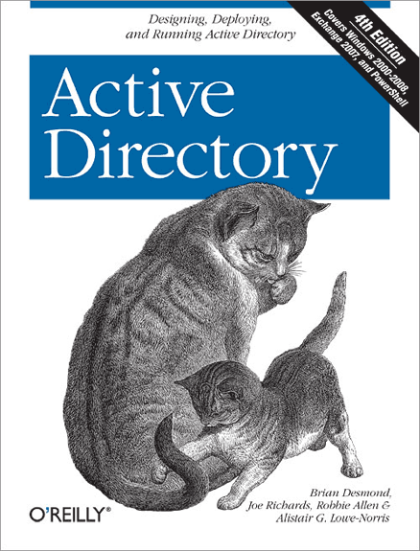
Active Directory, 4th Edition
Best selling Active Directory title
What’s New?
Windows Server 2008 coverage:
  Read Only Domain Controllers (RODCs)
  Fine Grained Password Policies (FGPPs)
  Auditing and security improvements
  Windows Server 2008 upgrade procedure
  DNS enhancements (such as GlobalName zones)
Exchange 2007 integration & scripting
Windows PowerShell & Active Directory.NET Active Directory programming
New user interface features
Lots of new diagrams and figures
Learn More! www.briandesmond.com/ad4/

Slide 28
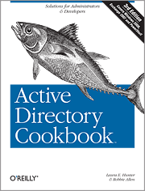
AD Cookbook, 3rd Edition
Best selling Active Directory title
What’s New?
Windows Server 2008 coverage:
  Read Only Domain Controllers (RODCs)
  Fine Grained Password Policies (FGPPs)
Exchange 2007 integration & scripting
Identity Lifecycle Manager 2007
Windows PowerShell & Active Directory .NET programming
New user interface features
Always more than one way!
Learn More! http://oreilly.com/catalog/9780596521103/

Slide 29

Questions?

Slide 30



www.morantechnology.com
http://www.oxfordcomputergroup.com

