Slide 1


Active directory – Windows Server 2008 & R2 – what’s new
Brian Desmond
Moran Technology Consulting
www.morantechnology.com
www.briandesmond.com

Slide 2
About Me
Chicago based
Active Directory & Exchange consultant
MS MVP for Active Directory since 2003
Author of Active Directory, 4th Ed from O’Reilly
  You should own a copy!
e-mail: brian.desmond@morantechnology.com
e-mail: brian@briandesmond.com
website & blog: www.briandesmond.com

Slide 3
Agenda
BitLocker
Server Core
Managed Service Accounts
Read-Only Domain Controllers
Fine Grained Password Policies
Deleted Object Management

Slide 4
BitLocker
New feature in Windows Vista
Addresses the missing pieces from EFS
  Encrypts the system volume, including the page file and hibernation files
Whole drive/volume encryption
  Prevents the “remove the hard drive from a stolen laptop” attack
  Encrypts “early boot components” and detects any changes (either from the above or from malware)
  Trusted Platform Management (TPM) chip or pin/USB key

Slide 5
BitLocker – Administrative Issues
High security environments can require a pin # or USB key before the system will boot
  Do you have 24x7 data center coverage? If not, be wary of this feature on a server.
BitLocker is not a replacement for EFS!
Notes:
BitLocker protects the whole drive at boot
No protection from user A seeing user B’s files post boot
EFS solves this problem

Slide 6
BitLocker Recovery Passwords
All Bitlocker deployments require a copy of the recovery password to be stored somewhere
Out of the box, your users must save their own recovery password
  This probably isn’t the best plan…

Slide 7
Recovery Passwords in AD
Requires Windows Server 2003 SP1 or newer domain controllers
What about deleted computer accounts?
  Sales guy who’s always on the road
  High-powered exec who goes on a 3-month sabbatical
Possible Increase in size for NTDS.DIT
  Test labs, “Ghosted” environments that add/delete hundreds of machines can increase database size

Slide 8

Windows 7 Improvements
BitLocker ToGo
  Encrypt removable storage (e.g. USB Keys)
  Require USB Key encryption for write access
  Windows 7 Enterprise/Ultimate SKUs
Universal Recovery Key: Data Recovery Agent
BitLocker partitioning done during setup
Notes:
Required encryption – use Group Policy
Enterprise SKU targeted to volume licensing customers
Ultimate SKU targeted to retail customers
Universal DRA counteracts the need to store an individual key for each machine in AD

Slide 9
BitLocker Demo

Slide 10
Agenda
Server Core
Managed Service Accounts
Read-Only Domain Controllers
Fine Grained Password Policies
Deleted Object Management

Slide 11
What is Server Core?
New Installation Option for W2K8
  Not a separate SKU, does not require separate CALs
Security benefits
  Smaller installation footprint
  “Less friendly” UI leads to less “tinkering” in branch office scenarios
Administering Server Core
  Only specific services/roles can be installed
  Limited GUI – but not totally gone!
  Remote administration can use any GUI tools you’d like

Slide 12
Operational Concerns for Server Core
Application compatibility for Server Core
  Impact on anti-virus and other tools
  Windows Server 2008 R2 adds .NET
Administrative learning curve
“Can I ‘upgrade’ a Server Core install to a full installation?”
  No, requires full re-install of the OS
Notes:
Learning Curve - Can you do your job with the GUI for a day?
.NET - Some libraries are not included
http://blogs.technet.com/server_core/archive/2008/11/25/net-2-0-and-server-core-in-windows-server-2008-r2.aspx
http://blogs.technet.com/server_core/archive/2008/12/19/net-3-0-and-3-5-in-windows-server-2008-r2-server-core.aspx

Slide 13
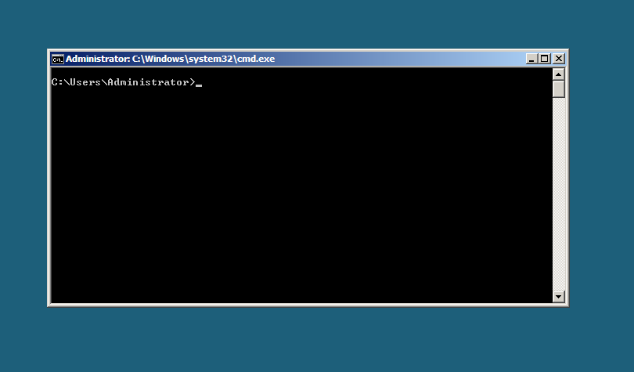
Server Core Demo

Slide 14
Agenda
Server Core
Managed Service Accounts
Read-Only Domain Controllers
Fine Grained Password Policies
Deleted Object Management

Slide 15













Read-Only Domain Controllers
Admin Role Separation
1-Way Replication
RODC Server Admins needn’t be Domain Admins
Prevents Branch Admins from accidentally causing harm
Delegated promotion
No replication from RODC to Full-DC
Change on RODC does not propagate to the entire enterprise
RODC
Secrets not cached by-default
Policy to configure caching branch specific secrets on RODC
Policy to configure custom schema attributes as secrets
Branch Office

Slide 16
Active Directory – No RODCs
Branch Office
Branch Office
Hub Site
Branch Office
Branch Office
Notes:
Every domain controller stores all the secrets
Domain controllers in branch offices are high risk
DMZ domain controllers are potentially high risk
A stolen domain controller can necessitate domain-wide password resets
Every attribute is replicated to every domain controller
Only trusted individuals are allowed to login locally

Slide 17

Domain Controller Secret Security
Branch Office
Branch Office
Hub Site
Branch Office
Branch Office
Domain-wide Password Reset!
Notes:
Every domain controller stores all the secrets
Domain controllers in branch offices are high risk
DMZ domain controllers are potentially high risk
A stolen domain controller can necessitate domain-wide password resets
Every attribute is replicated to every domain controller
Only trusted individuals are allowed to login locally

Slide 18
Active Directory –RODCs
Branch RODC
Branch RODC
Hub Site
(RWDC)
Branch RODC
Branch RODC
Notes:
RODCs cache a defined set of secrets
RODCs in branch offices are very low risk
DMZ RODCs are low risk
A stolen RODC can necessitate a small set of password resets
Attributes can be selectively not replicated to RODCs
Un-trusted individuals can safely login locally

Slide 19
RODC Secret Security
Branch RODC
Branch RODC
Hub Site
(RWDC)
Branch RODC
Branch RODC
Just a few Password Resets
Notes:
Every domain controller stores all the secrets
Domain controllers in branch offices are high risk
DMZ domain controllers are potentially high risk
A stolen domain controller can necessitate domain-wide password resets
Every attribute is replicated to every domain controller
Only trusted individuals are allowed to login locally

Slide 20
Password Replication Policy
Defines what secrets are cached on the RODC
Stored on a per RODC basis
  Authenticated To List
  Cached Passwords List
  Caching Allowed List
  Caching Denied List
Cached passwords are removed when they expire or are changed
Every RODC has a separate krbtgt account
(the krbtgt account encrypts Kerberos Tickets)
Notes:
Talk about what you use the lists for
Every RODC has a separate krbtgt account

Slide 21
How it Works
User Login Request
RODC Checks Cache
RODC forwards to 2008 writeable DC
2008 RWDC authenticates user
2008 RWDC returns authentication to RODC
RODC sends success to user
RODC generates replication request for secret
Hub Site DC checks PRP to see if password can be cached
Hub Site DC replicates password to RODC
3
2
7
4
5
Branch RODC
8
9
Hub Site
(RWDC)
6
1
End User

Slide 22
Agenda
Server Core
Managed Service Accounts
Read-Only Domain Controllers
Fine Grained Password Policies
Deleted Object Management

Slide 23
Fine Grained Password Policies
Limitless password and lockout policies per domain
Linked to directly to users or via groups
  No OU based linking!
Create with ADSIEdit – no FGPP GUI
  Windows 7 adds PowerShell cmdlets
  3rd Party tools available
Notes:
FGPPs removes a key driver for multi-domain forests
Discuss multiple policies can be linked
Use precedence
Keep it simple (KISS)
Other tools – psomgr from www.joeware.net, various 3rd party UIs (www.specopssoft.com)

Slide 24
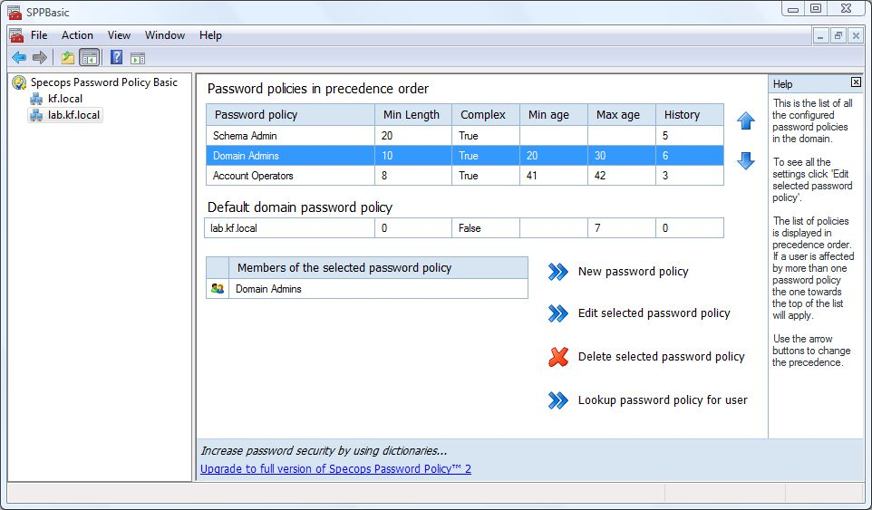
FGPP Management Tools
SpecOps Password Policy Basic - http://www.specopssoft.com

Slide 25
Agenda
Server Core
Read-Only Domain Controllers
Fine Grained Password Policies
Managed Service Accounts
Deleted Object Management

Slide 26
Service Accounts Today
Huge Security Hole
Passwords never changed
Nobody knows who knows the password
Every service using the account is often unknown

Slide 27
Managed Service Accounts
Windows Server 2008 R2 feature
Service account password managed by server automatically
One-to-one service account to machine relationship
Notes:
Password management done via netlogon secure channel
New object type in AD
Service account password mgmt - No administrator intervention required!
Explain 1-to-1 relationship with distributed services (e.g. SQL)

Slide 28
Agenda
Server Core
Read-Only Domain Controllers
Fine Grained Password Policies
Managed Service Accounts
Deleted Object Management

Slide 29
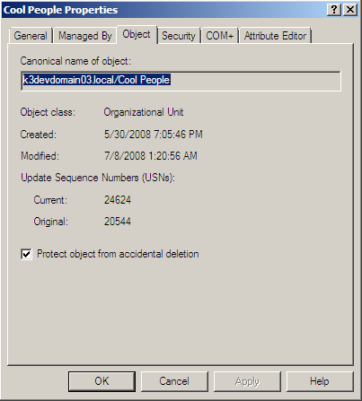
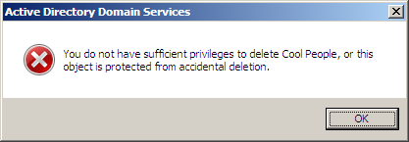
Accidental Deletion Protection
Checkbox in Windows Server 2008 administrative tools
Adds an ACL to the object preventing Delete for Everyone

Slide 30


Recycle Bin Object Lifecycle
180 Days
Live Object
Tombstone Object
Garbage collection
Windows Server 2008
Returns Tombstones
LDAP OID 1.2.840.113556.1.4.417
Windows Server 2008 R2 w/ Recycle Bin
(If not enabled, behavior is similar to Windows Server 2008)
Returns Deleted
LDAP OID 1.2.840.113556.1.4.2064
Returns Deleted and Recycled
Live Object
Deleted Object
Recycled Object
Garbage collection
180 Days
180 Days

Slide 31
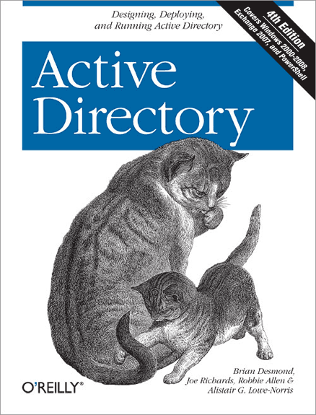
Active Directory, 4th Ed
Best selling Active Directory title
What’s New?
Windows Server 2008 coverage:
  Read Only Domain Controllers (RODCs)
  Fine Grained Password Policies (FGPPs)
  Auditing and security improvements
  Windows Server 2008 upgrade procedure
  DNS enhancements (such as GlobalName zones)
Exchange 2007 integration & scripting
Windows PowerShell & Active Directory.NET Active Directory programming
New user interface features
Lots of new diagrams and figures
Learn More! www.briandesmond.com/ad4/

Slide 32
Questions?

Slide 33
Thank You!

Slide 34
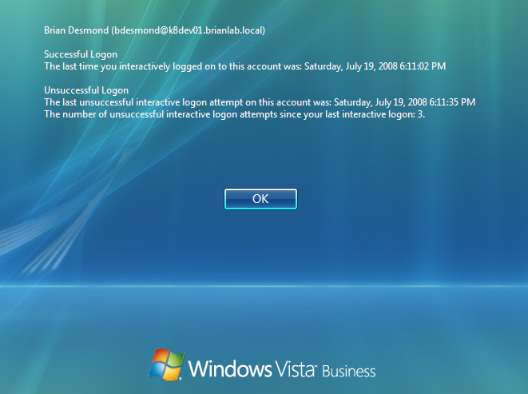
LLTS Tracking Screenshot
Notes:
Four attributes in AD track this
Not enabled by default
Common Criteria compliance
Not recommended due to replication load

Slide 35
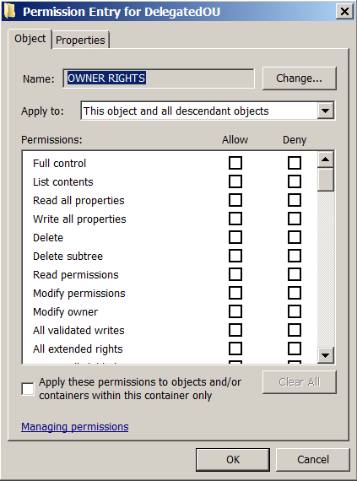
Owner Access Restriction
Separates Owner access from Creator access
  Remember CREATOR OWNER?
Owners can modify permissions by default
  Use OWNER RIGHTS to prevent this
Notes:
http://technet.microsoft.com/en-us/library/dd125370.aspx

Slide 36
Active Directory Recycle Bin
Accidental deletions are the leading causes of Active Directory outages
Pre Win7, undelete is severely limited
Recycle Bin is a WS08R2 Forest Functional Level feature
Use PowerShell to restore objects
No out-of-box UI included
Notes:
Deleted objects prevent logons, application functionality, etc.
No linked attributes (e.g. groups) can be restored, most attributes excluded by default
Recycle bin must be explicitly enabled to use the recycle bin

Slide 37
Active Directory Auditing
Pre Windows Server 2008 Active Directory auditing was not very helpful
New auditing introduces:
  Granularity
  Before and after data in audits
  Separate events for different types of operations

Slide 38
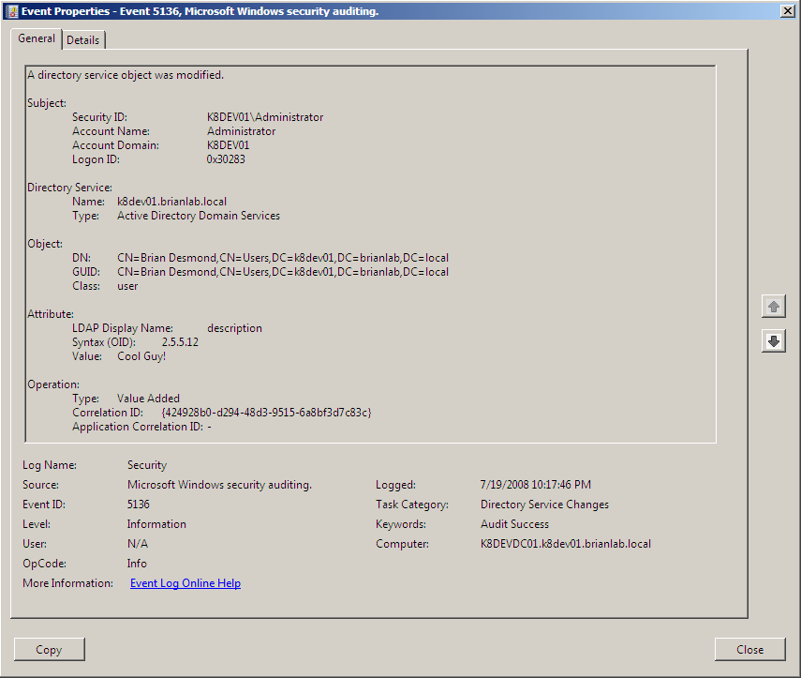
Sample Audit Event

